Slide 1
International eLearning University
Hossein Akhlaghpour
ObjectJ Inc.
hossein@objectj.com

Slide 2
Outline
What do we mean by eLearning University?
What are the obstacles of having an eLearning University?

Slide 3







History of eLearning
Since 1998
eLearning in Industry & Academy

Slide 4
Largest eLearning School
University of Phoenix, online
Compare the real univ with online
4000000 students
50 different courses

Slide 5
A typical top US university annual budget ~ $2 billion

Slide 6
eLearning in Iran
XX many student in UT took X many course in eLearning format
Elmosanat took about 1000 student and is increasing its capacity 2 times
X many hours of courses is seen by student in the last 6 months
X many mentors
We predict the number of student increases to X many this year (by joining KhajehNasir & possibly Oloom Pezeshki)

Slide 7
Fermat Learning Group

Slide 8
Full Scale eLearning University
Cost of course development
40 departments
40 courses / department
1600 courses
20 hours of eLearning content / course
32000 hours of eLearning content
$1000 / hour
$320 million is the cost of course development
Lifetime of 10 year => $32 million / year

Slide 9
Full Scale eLearning University
Cost of hardware/software
$2 million Software
$2 million hardware
10 people support ~ $2 million / year
Lifetime of 10 years => $2.4 million / year

Slide 12
You can mix & match different courses and create new course
You can mix & match courses from different dept and create new majors
You can mix & match eLearning with conventional learning
Show a course that every parts of it comes from different part

Slide 13
Reporting Portlet
Report B
Report C
Report A
View Generator
Reporting Portlet
Skin Customizer
Template Lookup
WS Plugin
Web Services

Slide 14
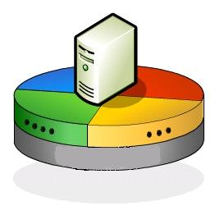


Develop new WS-HL7 System
Reporting Portlet
Portal
Web Services
Web Services Plug-in
Clinic
Lab
Database
Database
RMI
JMS
HL7 Adapter

Slide 15

Design & Development Team Profile
WS Group
(2-5)
Project Manager
Portal Group
(2-4)
HL-7 Group
(2-4)
Use Cases & UI Group
(4-6)
Development Groups
(2-5 * 2-4)
Integration Group
(2-4)

Slide 16
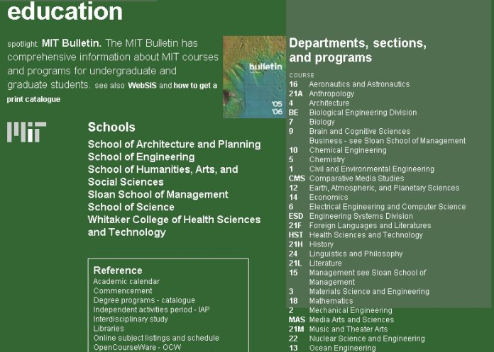

Slide 17
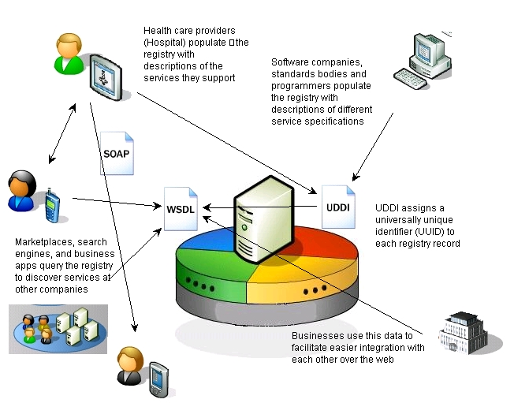
SOA (Web Services)

Slide 18

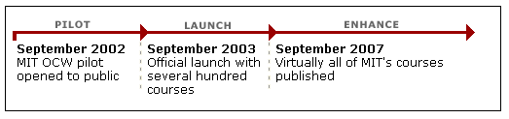
OpenCourseWare Project
Aeronautics & Astronautics
Anthropology NEW
Biology
Chemical Engineering
Chemistry
Civil & Environmental_x000b_Engineering
Comparative Media Studies NEW
Earth, Atmospheric, &_x000b_Planetary Sciences
Economics
Electrical Engineering &_x000b_Computer Science
Engineering Systems Division b
History NEW
Linguistics & Philosophy
Literature NEW
Materials Science &
Engineering NEW
Mathematics
Mechanical Engineering
Nuclear Engineering NEW
Ocean Engineering
Physics
Political Science
Sloan School of Management
Urban Studies & Planning

Slide 19



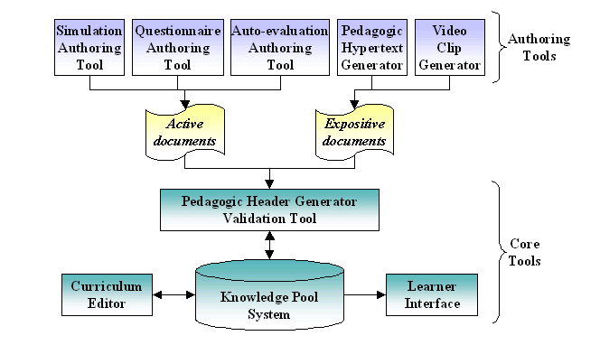




eLearning Standards
IMS Content Packaging (IMS CP)
IMS Digital Repositories Specification
IMS Enterprise Specification
IMS Learner Information Package (IMS LIP)
IMS Learning Design Specification
IMS Question & Test Interoperability (IMS QTI)
IMS Reusable Definition of Competency or Educational Objective (IMS RDCEO)
IMS Simple Sequencing Specification
IEEE Learning Object Metadata (LOM)

Slide 20
eLearning Technology
Authoring
Tool/ LCMS
ICT Systems
LMS
Assessment
Tool
Develop Courses
Present Courses to Students
Track Students Usage
Get Student Feedback
Connect Student & Instructors
Makes eLearning systems to work together
Connect eLearning to Other Systems
Virtual
Classroom

Slide 21
LCMS
Admit students (Admission)
Assign students to departments
Assign courses to departments
Determine the course hierarchy: prerequisite between courses
Register courses for students or allow them to register courses considering their hierarchy
Track student's usage (whether student has viewed lessons).

Slide 22




LCMS
Content
Progress
Report
Author
Content
Progress
Report
Live
Instructor
Student

Slide 23
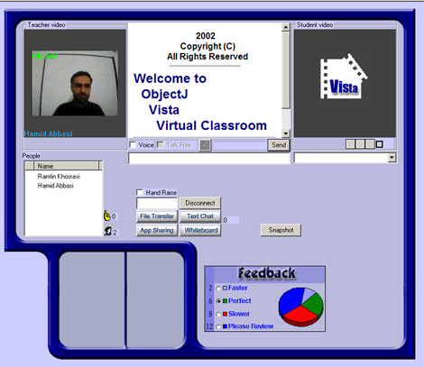


eLearning Virtual Classroom
Student
Video
Instructor
Video
Professional
Services
Students
List
Class
Feedback

Slide 24

eLearning Infrastructure

Slide 25
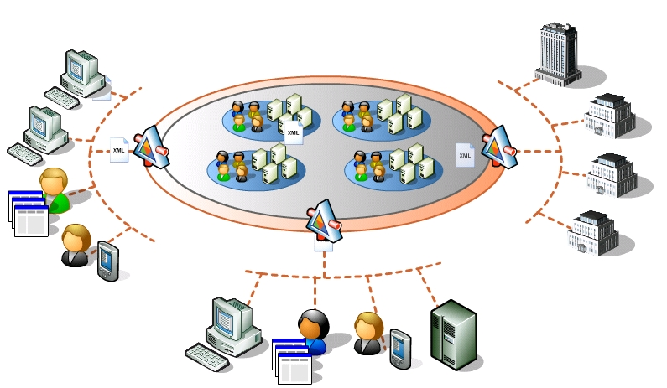

Slide 26




High Availability (Clustering)

Slide 27


Web Servers Load Balancing to A Cluster of J2EE based Servers
J2EE
Platform-based
Server
Web server
Data base
Internet
Cluster of J2EE
Platform-based servers
Firewall
Router
Web server
J2EE
Platform-based
Server

Slide 28
Technical Infrastructure
Hospital
Physically Secure Area
Web Services
HTTPS
Application
Server
Web server
Web Services
Database
Internet
Firewall
DMZ
HTTP
SSL
Secure
Line
DSA
Web server
HL-7
SSL / ACL
Application
Server

Slide 29

Iterative Process for a HIPAA-like Adoption
Policy/Procedure
Technology
Legislation

Slide 30
Conclusion
Internationalization (separation of supply & demand)
Open courseware program is a base for future eLearning infrastructure
Learning group is the base for exchange programs and offering course to multinational (via host universities)
The best eLearning university will be recognized by the quality of their mentoring system & students
Eventually there won’t be any line between eLearning course and conventional courses and they merge together

